Slide 1

Remote Excavator Team
Davis Geniza, Ryan Fortier, Alec Boyce, Zhiyu Wang, Oscar Nunez

Slide 2
Project Description
Our goal is to design a small scale, remote controlled excavator that is fully electric.
This style of excavator will reduce the amount of emissions produced by the construction industry.
In addition to a smaller carbon footprint, this design will eliminate the need for operators on site.
Sponsored by Dr. Trevas/NAU

Slide 3
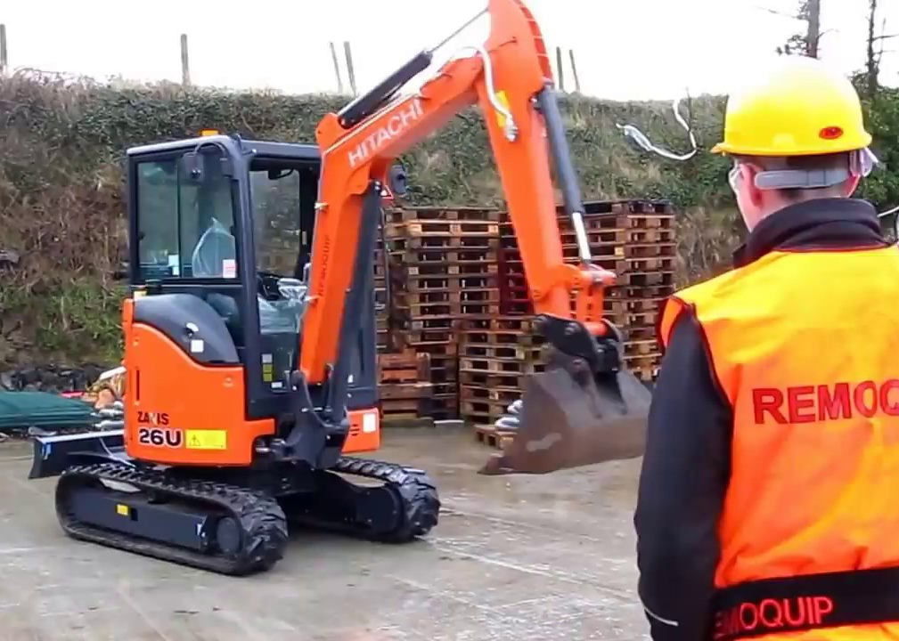
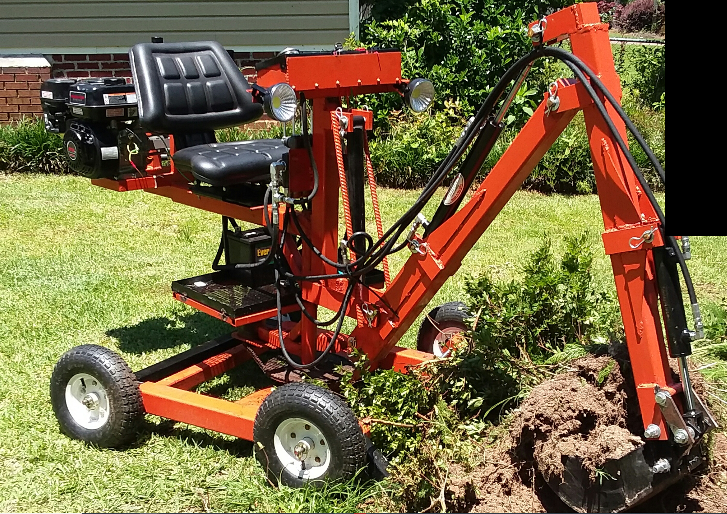

SOTA & Background
Design an excavator that runs on electricity rather than combustion engine to reduce emissions
Controlling excavator remotely
Backyard excavator
Current designs are available but not in the size or budget that is required

Slide 4
Customer & Engineering Requirements
What is required from the client?
Durability Must dig 1'x6" trench
8 Hour Workday Large excavation
What features are "must have"
Electric Powered Wide range of remote control
What features are "nice to have"
Ground Penetrating Radar Wireless Control
Describe how all of the engineering requirements are quantified
Material, Hydraulic system, Battery, Electrical system, Signal transmission

Slide 5
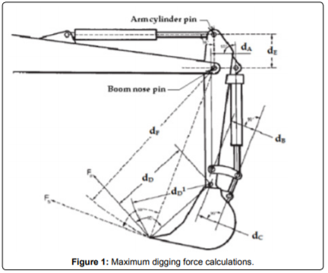
Skills Acquired
Arduino, for electrical control and remote operation
Motion and systems control
Finite Element Analysis & Solid Works Animation
Battery systems research
Geometric calculations: bucket

Slide 6
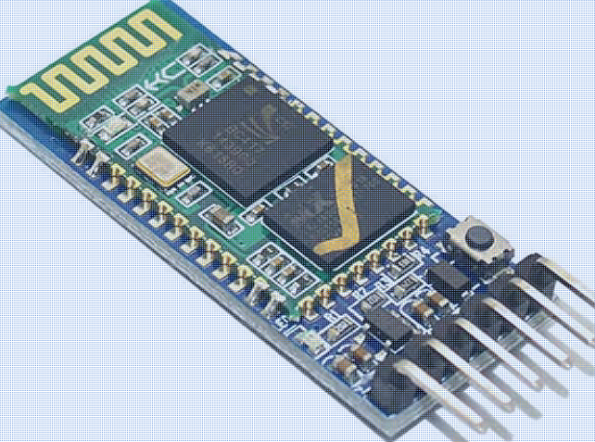
Considered Concepts
Wheels vs. Track system
Lead acid batteries
Electric actuator vs. Hydraulic actuator
Arm connection: Pinned vs. Fixed
Remote Control: Phone vs. Controller
Arduino Bluetooth Module vs. Wired connection

Slide 7
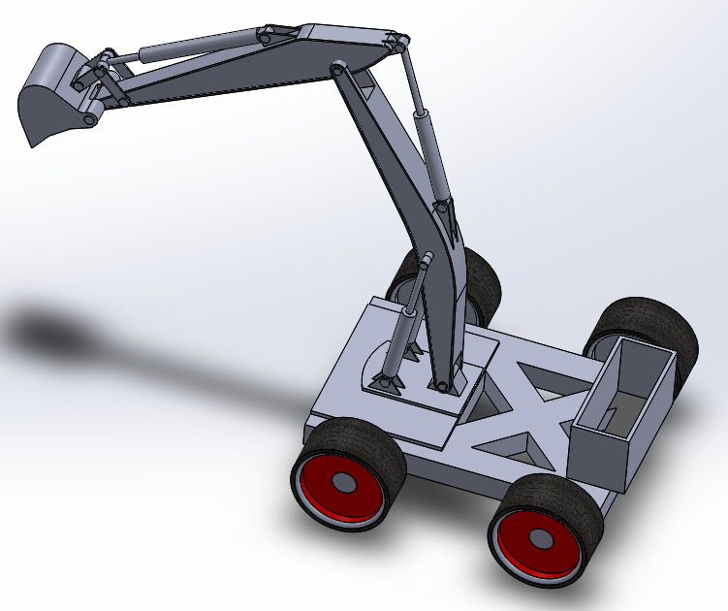
Concept Eval
Small-Scale prototype consideration
Satisfying Engineering requirements
Our current design:
Bucket Size: Width is 6 inches and Depth is 12 inches
Lower arm size: approx. 45 inches
Upper arm size: approx. 45 inches
Body Size: Width is 2 ft and length is 3 ft

Slide 8
Citations
Customer Builds. (n.d.). Retrieved July 15, 2020, from https://turbot-plantain-6xf6.squarespace.com/customer-builds
Remoquip | Remote Control for Heavy Equipment | Create your own demolition robot using Remoquip Remote. (2020). Remoquip. https://remoquip.com/\

